Slide 1


SIGNIFICANCE OF MFA IN SECURITY
Syed Sheeraz Ali Shah

Slide 2


What is Multi-Factor Authentication (MFA)
Multi-Factor Authentication (MFA) is an advanced security measure that requires users to provide two or more verification factors to access a system, application, or account. This approach strengthens security by combining something the user knows (e.g., a password), something they have (e.g., a smartphone or security token), and something they are (e.g., fingerprint or face recognition). By requiring multiple factors, MFA minimizes the risk of unauthorized access from password theft or brute-force attacks.

Slide 3
How MFA Works?

Slide 4
Multi-Factor Authentication (MFA) enhances security by requiring users to verify their identity using two or more independent factors when logging into an account or system. Here's how it works:
First Factor – Something You Know:
This is usually your password or PIN.
Second Factor – Something You Have or Are:
After entering your password, you're prompted for a second factor, which could be:
Something You Have: A one-time code from an authentication app, an SMS, or a hardware token.
Something You Are: Biometric verification, such as a fingerprint or facial recognition.

Slide 5
3.Verification Process:
The system sends a unique code or challenge to the second factor (e.g., an app, token, or phone).
The user inputs or confirms this second factor to prove their identity.
4.Access Granted:
Once the second factor is successfully verified, the user is granted access to the account or system.
5.Backup Methods:
If the user can't access their second factor (e.g., phone lost), backup options like recovery codes or alternative factors allow them to regain access.
By combining two or more verification methods, MFA greatly reduces the chances of unauthorized access, even if a password is compromised.

Slide 6
Setting Up MFA
.
Step 1. Choose you Method:
Authentication App: Use apps like Google Authenticator or Microsoft Authenticator to generate time-based codes.
SMS Codes: Receive one-time passcodes via text message.
Hardware Token: Use a physical security device, such as a YubiKey.
Step 2. Link your method:
For authentication apps: Scan the QR code provided by the service or manually enter a code to link the app.
For SMS: Enter your phone number to receive SMS codes.
For hardware tokens: Register the token with the service
Step 3. Test the Method:
After setting up, test the MFA to ensure everything works by logging out and back in to confirm you receive the authentication prompt.

Slide 7
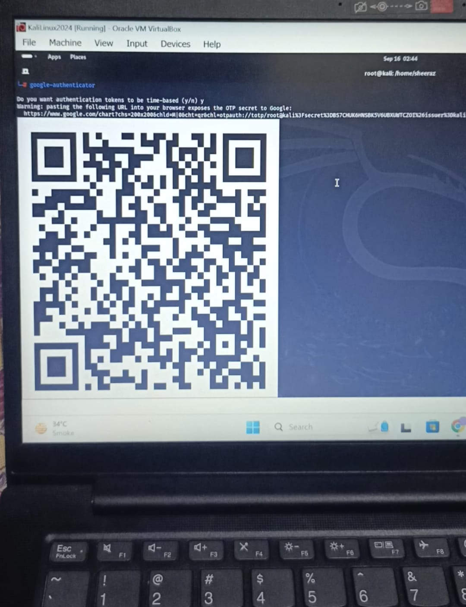
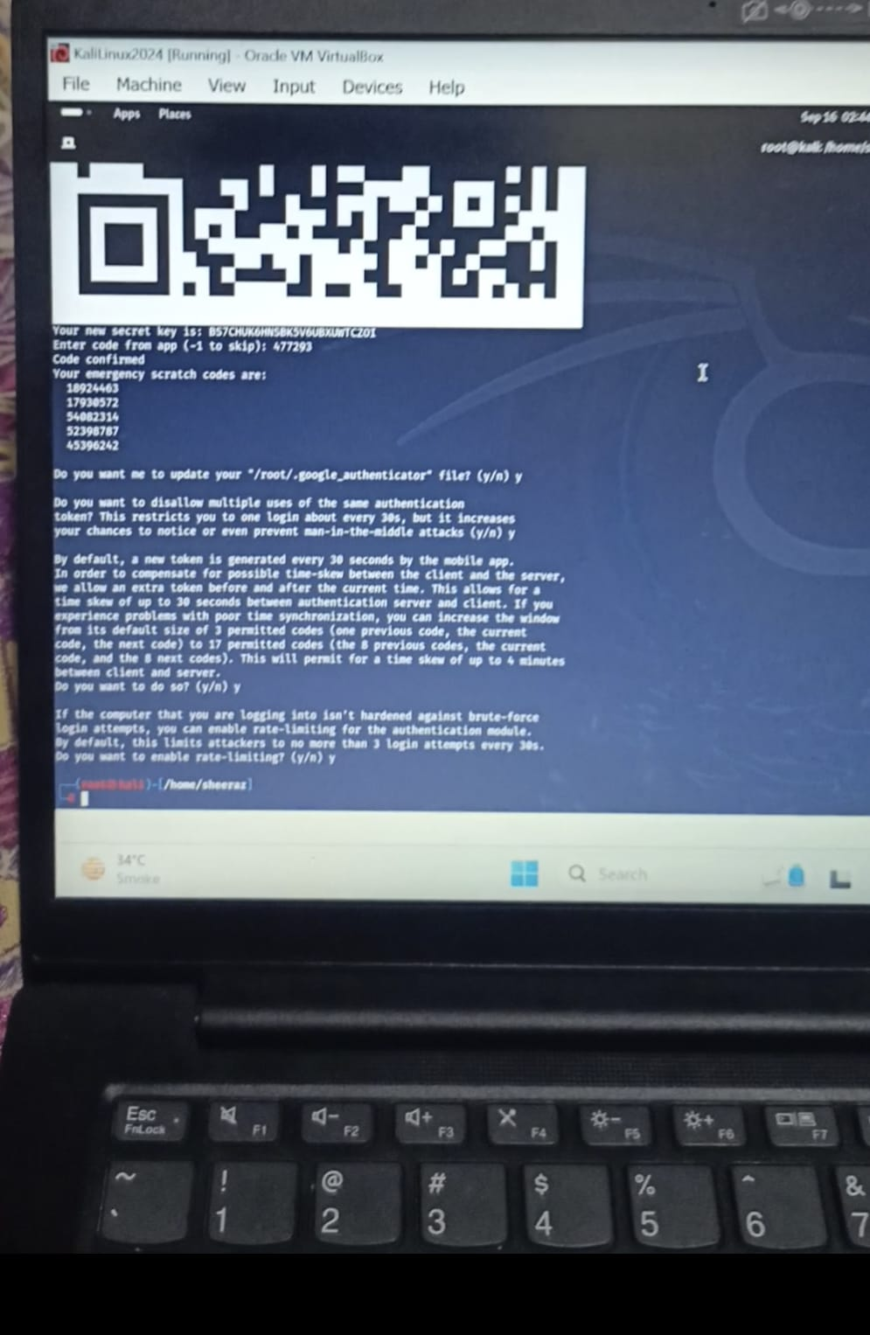
I used Google Authenticator as MFA in my both devices and implemented MFA.

Slide 8
MFA Uses
Online Accounts: Protects email, social media, and banking accounts.
Work Accounts: Secures corporate systems, VPNs, cloud services, and enterprise software.
Device Security: Adds protection to phones, laptops, and IoT devices using biometrics or tokens.
E-commerce and Healthcare: Ensures secure access to shopping platforms and healthcare portals.

Slide 9
Best Practices
Keep your device secure:
Protect the device used for MFA to prevent unauthorized access.
Update Regularly:
Update your MFA settings when changing devices

Slide 10
Benefits
Stronger Security: Prevents unauthorized access even if passwords are stolen.
Protection from Phishing: Stops attackers from using stolen credentials.
Regulatory Compliance: Helps meet security requirements for data protection.

Slide 11
Common Risks and Issues
Lockout Risk: Losing access to the second factor (e.g., phone or token) can lead to being locked out of accounts.
Complex Setup: Some users may find setting up MFA confusing or difficult.
--Despite these challenges, MFA significantly boosts security and is worth the trade-offs in most cases.

Slide 12

Conclusion
I used Google authenticator as MFA tool.
Configured it in Kali Linux and also in mobile app.
Tested it by entering the code generated by mobile app.
It added a multi layers of security to the device on which MFA is implemented.
MFA is very secure and provides ultra security even when the password is compromised by the attackers.
MFA is very beneficial for every user in the field to protect its confidential data and devices.

